Slide 1
KUBERNETES

Slide 2
What is Kubernetes
Kubernetes often abbreviated as "K8s," is an open-source platform for automating the deployment, scaling, and management of containerized applications.
Originally developed by Google and now maintained by the Cloud Native Computing Foundation (CNCF)
Kubernetes has become the standard for container orchestration, supporting complex applications and microservices architectures.

Slide 3
Key Concepts of Kubernetes
1. Containers and Container Orchestration:-
Containers package applications and their dependencies, allowing them to run consistently across different environments. Kubernetes orchestrates containers, managing their lifecycle, scaling, and networking.
2. Nodes and Clusters:-
A node is a physical or virtual machine where Kubernetes manages containerized applications. A cluster is a set of nodes controlled by Kubernetes.
The Master Node (or control plane) manages the cluster, while Worker Nodes handle the workload.

Slide 4
3. Pods:-
The smallest deployable unit in Kubernetes, a Pod encapsulates one or more containers that share the same network namespace and storage.
Each Pod typically runs a single application container but can include sidecar containers for additional functions.
4. Replication Controllers and ReplicaSets:-
These ensure that a specified number of pod replicas are running at any given time.
ReplicaSets replaced Replication Controllers as the standard, offering more advanced control over pod management.
5. Deployments:-
A Deployment manages ReplicaSets and pods, enabling easy scaling, updates, and rollbacks for applications.
Deployments make Kubernetes highly resilient, allowing you to update and roll back applications with minimal downtime.

Slide 5
6. Services:-
Services provide stable IPs, DNS, and load balancing for Pods.
Kubernetes services enable communication between different Pods, supporting load balancing and ensuring that applications are reachable across the cluster.
7. Persistent Storage:-
Kubernetes provides persistent storage options that allow data to survive even if a Pod is deleted or rescheduled.
Examples include Persistent Volumes and Persistent Volume Claims, which abstract storage resources and manage storage in clusters.
8. ConfigMaps and Secrets:-
ConfigMaps store configuration data, while Secrets securely store sensitive information, such as passwords and keys, which can be injected into Pods as environment variables or mounted as files.

Slide 6
8. ConfigMaps and Secrets:-
ConfigMaps store configuration data, while Secrets securely store sensitive information, such as passwords and keys, which can be injected into Pods as environment variables or mounted as files.
Key Kubernetes Tools:-
kubectl: The command-line interface (CLI) tool for interacting with Kubernetes clusters.
Kubeadm: Simplifies the setup of Kubernetes clusters.
Helm: A package manager for Kubernetes, it allows you to define, install, and upgrade applications as “Helm charts.”

Slide 7
1. Pod: It is a deployment unit in Kubernetes with a single Internet protocol address.
2. Horizontal Scaling: It is an important feature in the Kubernetes. This feature uses
a HorizontalPodAutoscalar to automatically increase or decrease the number of pods in a deployment, replication controller, replica set, or stateful set on the basis of observed CPU utilization.
3. Automatic Bin Packing: Kubernetes helps the user to declare the maximum and minimum resources of computers for their containers.
4. Service Discovery and load balancing: Kubernetes assigns the IP addresses and a Name of DNS for a set of containers, and also balances the load across them.
5. Automated rollouts and rollbacks: Using the rollouts, Kubernetes distributes the changes and updates to an application or its configuration. If any problem occurs in the system, then this technique rollbacks those changes for you immediately.

Slide 8
6. Persistent Storage: Kubernetes provides an essential feature called 'persistent storage' for storing the data, which cannot be lost after the pod is killed or rescheduled. Kubernetes supports various storage systems for storing the data, such as Google Compute Engine's Persistent Disks (GCE PD) or Amazon Elastic Block Storage (EBS). It also provides the distributed file systems: NFS or GFS.
7. Self-Healing: This feature plays an important role in the concept of Kubernetes. Those containers which are failed during the execution process, Kubernetes restarts them automatically. And, those containers which do not reply to the user-defined health check, it stops them from working automatically.

Slide 9
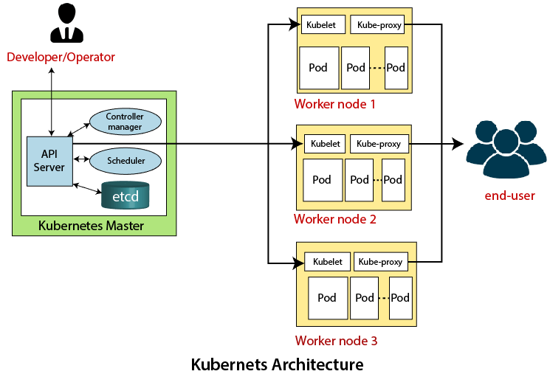
Kubernetes Architecture

Slide 10
The architecture of Kubernetes actually follows the client-server architecture. It consists of the following two main components:
Master Node (Control Plane)
Slave/worker node
Master Node or Kubernetes Control Plane
The master node in a Kubernetes architecture is used to manage the states of a cluster. It is actually an entry point for all types of administrative tasks. In the Kubernetes cluster, more than one master node is present for checking the fault tolerance.
Following are the four different components which exist in the Master node or Kubernetes Control plane:
API Server
Scheduler
Controller Manager
ETCD

Slide 11
1. API Server:-
The Kubernetes API server receives the REST commands which are sent by the user. After receiving, it validates the REST requests, process, and then executes them. After the execution of REST commands, the resulting state of a cluster is saved in 'etcd' as a distributed key-value store.
2. Scheduler:-
The scheduler in a master node schedules the tasks to the worker nodes. And, for every worker node, it is used to store the resource usage information. In other words, it is a process that is responsible for assigning pods to the available worker nodes.
3. Controller Manager:-
The Controller manager is also known as a controller. It is a daemon that executes in the non-terminating control loops. The controllers in a master node perform a task and manage the state of the cluster. In the Kubernetes, the controller manager executes the various types of controllers for handling the nodes, endpoints, etc.
4. ETCD:-
It is an open-source, simple, distributed key-value storage which is used to store the cluster data. It is a part of a master node which is written in a GO programming language.
Now, we have learned about the functioning and components of a master node; let's see what is the function of a slave/worker node and what are its components

Slide 12
Kubelet:-
This component is an agent service that executes on each worker node in a cluster. It ensures that the pods and their containers are running smoothly. Every kubelet in each worker node communicates with the master node. It also starts, stops, and maintains the containers which are organized into pods directly by the master node.
Kube-proxy:-
It is a proxy service of Kubernetes, which is executed simply on each worker node in the cluster. The main aim of this component is request forwarding. Each node interacts with the Kubernetes services through Kube-proxy.
Pods:-
A pod is a combination of one or more containers which logically execute together on nodes. One worker node can easily execute multiple pods.

Slide 13
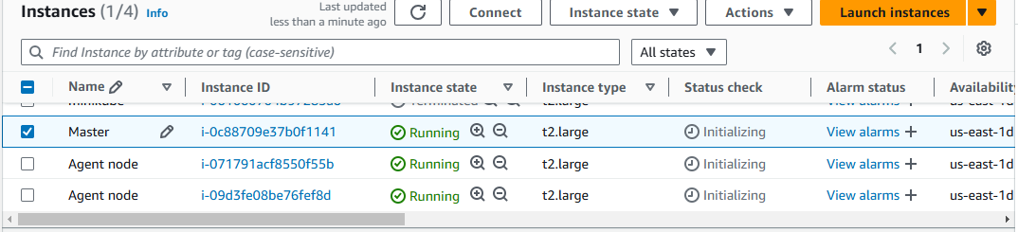
Kubernetes Installation
Before starting the installation process, ensure that the following prerequisites are met:
You have at least two Ubuntu 18.04 or higher servers available for creating the cluster.
Each server has at least 2GB of RAM and 2 CPU cores.
The servers have network connectivity to each other.
You have root access to each server.
I Create a 3instances,one is master,and another two is agent nodes
Connect with gitbash,mobaxterm,ec2 instance connect.

Slide 14
Update the system's package list ​
sudo su
sudo apt-get update​
sudo apt install apt-transport-https curl -y​
To install Containerd, use the following commands:
sudo mkdir -p /etc/apt/keyrings
curl -fsSL https://download.docker.com/linux/ubuntu/gpg | sudo gpg --dearmor -o /etc/apt/keyrings/docker.gpg
echo "deb [arch=$(dpkg --print-architecture) signed-by=/etc/apt/keyrings/docker.gpg] https://download.docker.com/linux/ubuntu $(lsb_release -cs) stable" | sudo tee /etc/apt/sources.list.d/docker.list > /dev/null
sudo apt-get update
sudo apt-get install containerd.io

Slide 15
Next, create the containerd configuration file using the following commands:
sudo mkdir -p /etc/containerd
sudo containerd config default | sudo tee /etc/containerd/config.toml
Edit the containerd configuration file to set SystemdCgroup to true
sudo nano /etc/containerd/config.toml
or use this command
sudo sed -i -e 's/SystemdCgroup = false/SystemdCgroup = true/g' /etc/containerd/config.toml
sudo systemctl restart containerd

Slide 16

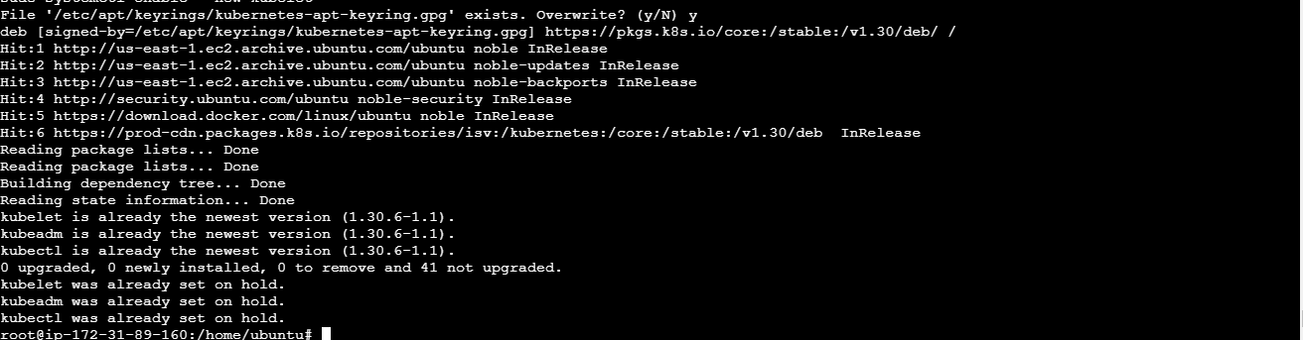
To install Kubernetes, use the following commands:
curl -fsSL https://pkgs.k8s.io/core:/stable:/v1.30/deb/Release.key | sudo gpg --dearmor -o /etc/apt/keyrings/kubernetes-apt-keyring.gpg
echo 'deb [signed-by=/etc/apt/keyrings/kubernetes-apt-keyring.gpg] https://pkgs.k8s.io/core:/stable:/v1.30/deb/ /' | sudo tee /etc/apt/sources.list.d/kubernetes.list
sudo apt-get update
sudo apt-get install -y kubelet kubeadm kubectl
sudo apt-mark hold kubelet kubeadm kubectl
sudo systemctl enable --now kubelet
Below image show the installation succefull

Slide 17
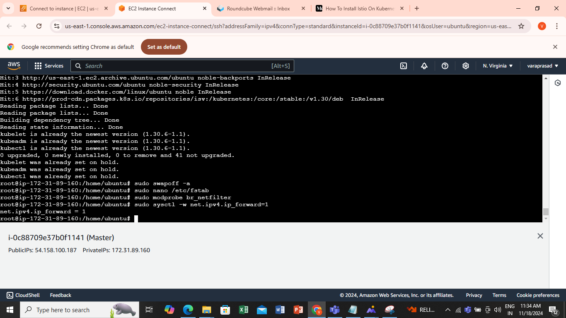
Disable swap using the following command:
sudo swapoff –a
If there are any swap entries in the /etc/fstab file, remove them using a text editor such as nano: no save &exit
sudo nano /etc/fstab
Enable kernel modules
sudo modprobe br_netfilter
Add some settings to sysctl
sudo sysctl -w net.ipv4.ip_forward=1
Again above commands run on another instances

Slide 18
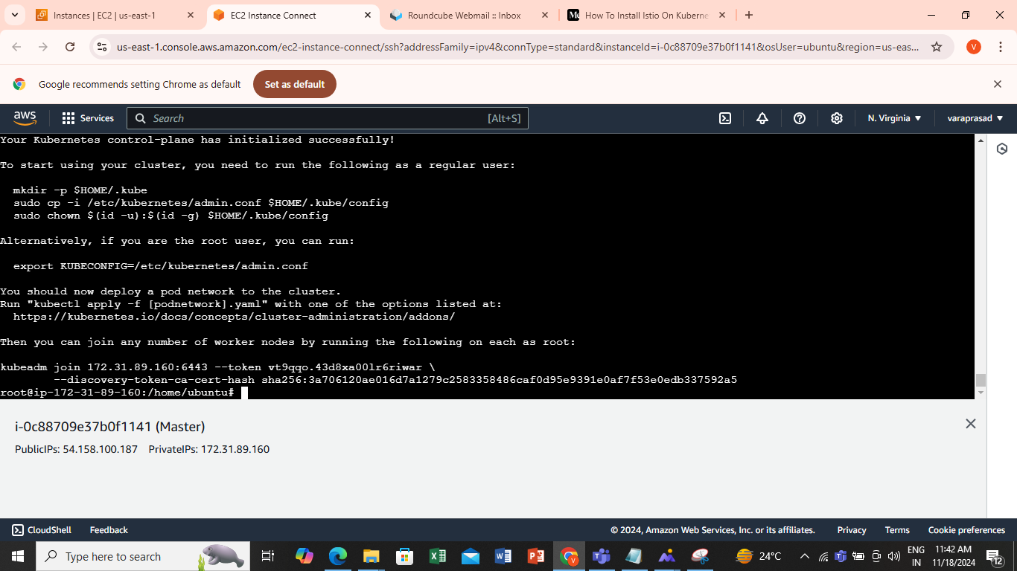
Initialize the Cluster (Run only on master)
Use the following command to initialize the cluster:
sudo kubeadm init --pod-network-cidr=10.244.0.0/16
Above image show the initialize the cluster
Create a .kube directory in your home directory:
mkdir -p $HOME/.kube
Copy the Kubernetes configuration file to your home directory:
sudo cp -i /etc/kubernetes/admin.conf $HOME/.kube/config
Change ownership of the file:
sudo chown $(id -u):$(id -g) $HOME/.kube/config

Slide 19
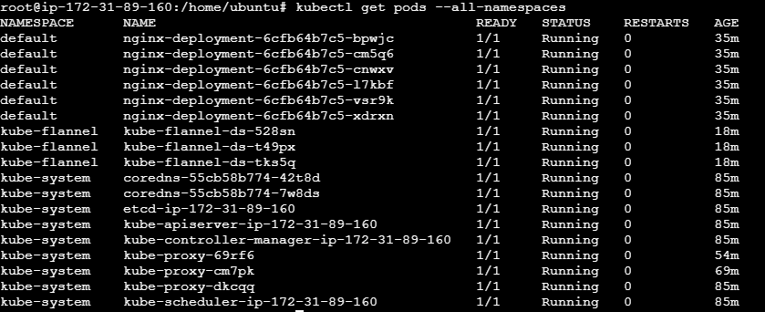
Install Flannel (Run only on master)
Use the following command to install Flannel:
kubectl apply -f https://github.com/flannel-io/flannel/releases/latest/download/kube-flannel.yml
Output like this
Verify Installation
Verify that all the pods are up and running:
kubectl get pods --all-namespaces

Slide 20
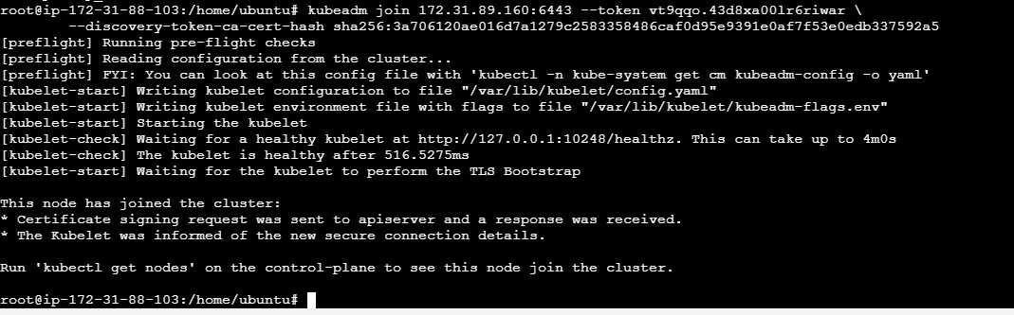
Use the following command to initialize the cluster:
sudo kubeadm init --pod-network-cidr=10.244.0.0/16
Above image show the connection with agent nodes url copy the selected in the image and paste it to the another agent nodes
So finally connected the working nodes with a master node and output be like this

Slide 21
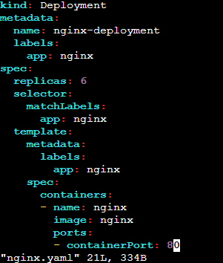
By applying the vi nginx.yaml command
vi nginx.yaml
Here the nginx.yaml file is shown below Code:
Apiversion:apps/v1
kind: Deployment metadata: name: nginx-deployment labels: app: nginx spec: replicas: 6 selector: matchLabels: app: nginx template: metadata: labels: app: nginx spec: containers: - name: nginx image: nginx ports: - containerPort: 80
:wq (save&quit)

Slide 22
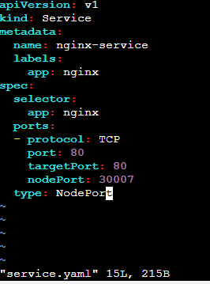
By applying the below command
kubectl apply -f nginx.yaml
Below image show that the nginx-deployment is successfully created
By applying the vi service.yaml below image shows that service.yaml file
Vi service.yaml
Code:
apiVersion: v1 kind: Service metadata: name: nginx-service labels: app: nginx spec: selector: app: nginx ports: - protocol: TCP port: 80 targetPort: 80 nodePort: 30007 type: NodePort
:wq(save&exit)

Slide 23
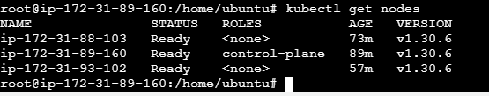
By applying the below command
kubectl apply -f service.yaml
Below image show the nginx-service is successfully created
By applying the below command
Kubectl get nodes

Slide 24
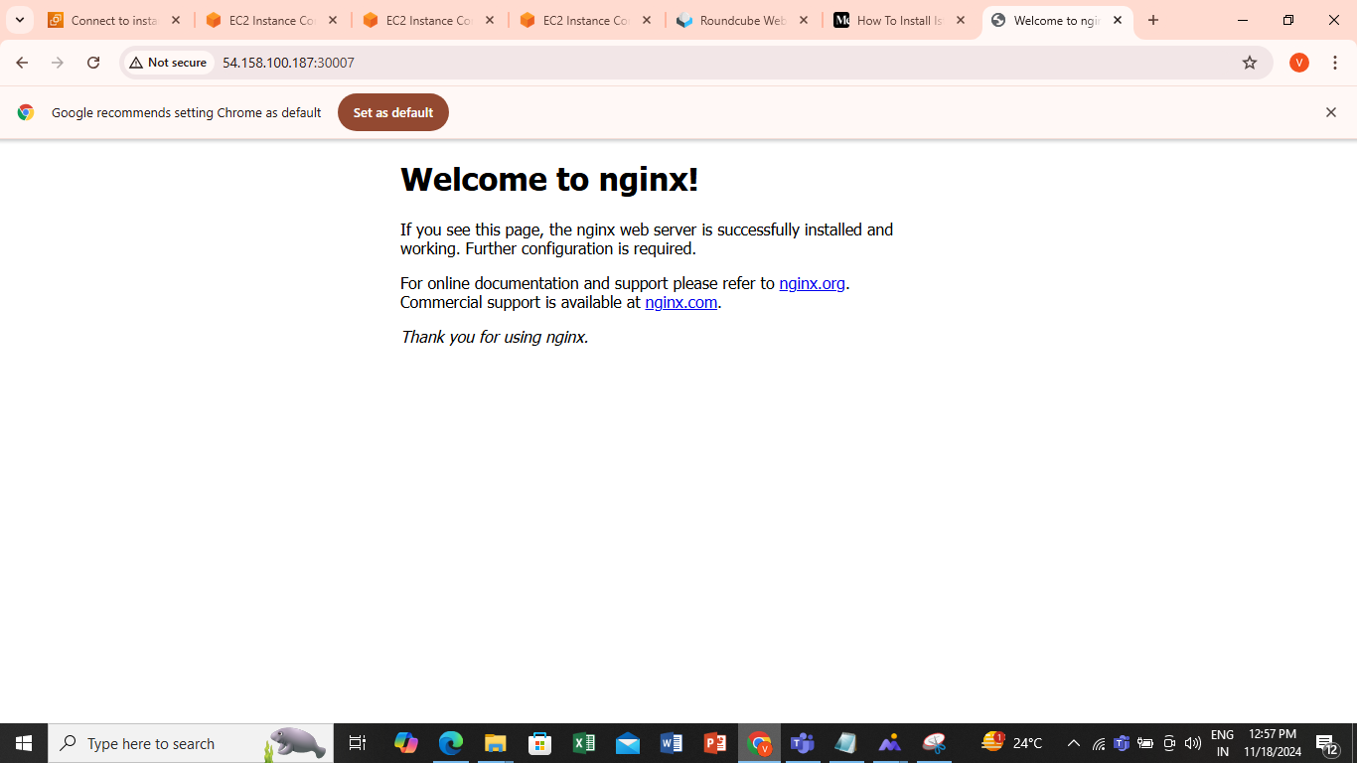
Here we take the publicIPV4 address of master node and portno:30007 ​

Slide 25


